Slide 1
ABC Airline Program
CPSC 2810 Final Project

Slide 2
Physical Mechanisms
Only authorized individuals can access hardware.
A key card is required to enter the building
A man trap is placed at the entrance of the lobby
A log is kept for all key card – reader activity

Slide 3
No unauthorized usage or users
All devices are connected via ethernet to the network.
A firewall is in place at the gateway of the network.
To connect from the outside, a VPN is required.
IDS is on the network.
All unnecessary ports are closed.

Slide 4
Assumptions
A VPN is being used to connect the networks
Only employees have access to the network
Shared files are stored on local file servers.
User files are stored on their device.
All employee customers are up to date on security patches.
Users are using Windows OS.

Slide 5

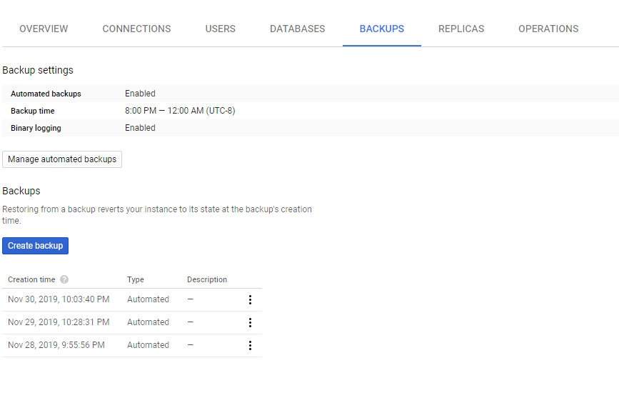
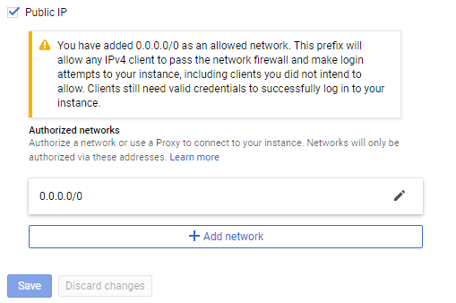
Database notes
The database is hosted via Google Cloud
Has various options for in terms of connectivity.
Can allow IP ranges.
Automatically backups database.
Able to configure SSL certificates.
For simplicities sake, we will stick with a whitelist.

Slide 6

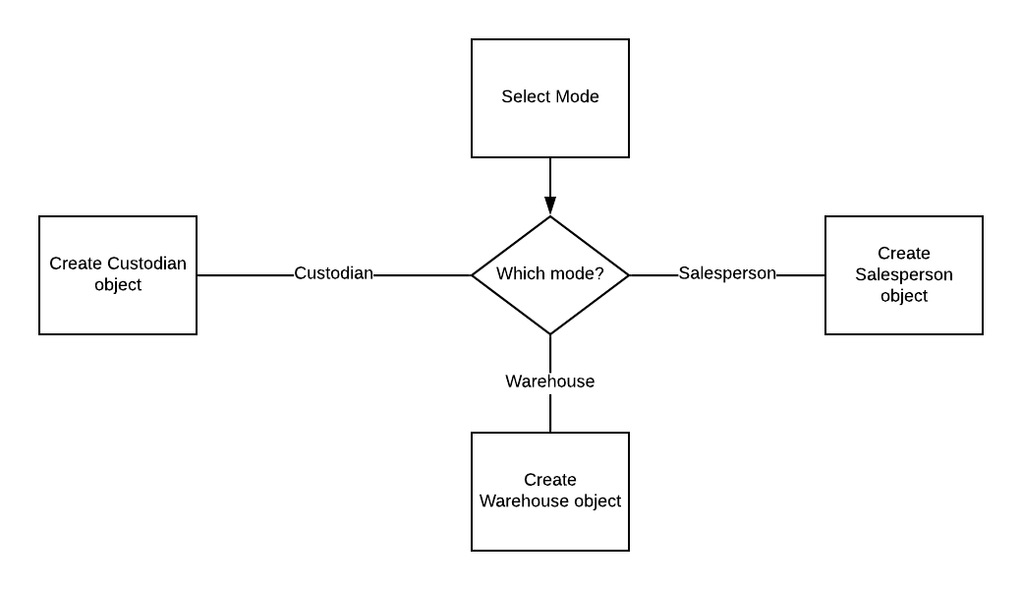
Role Based Database Program flow

Slide 7
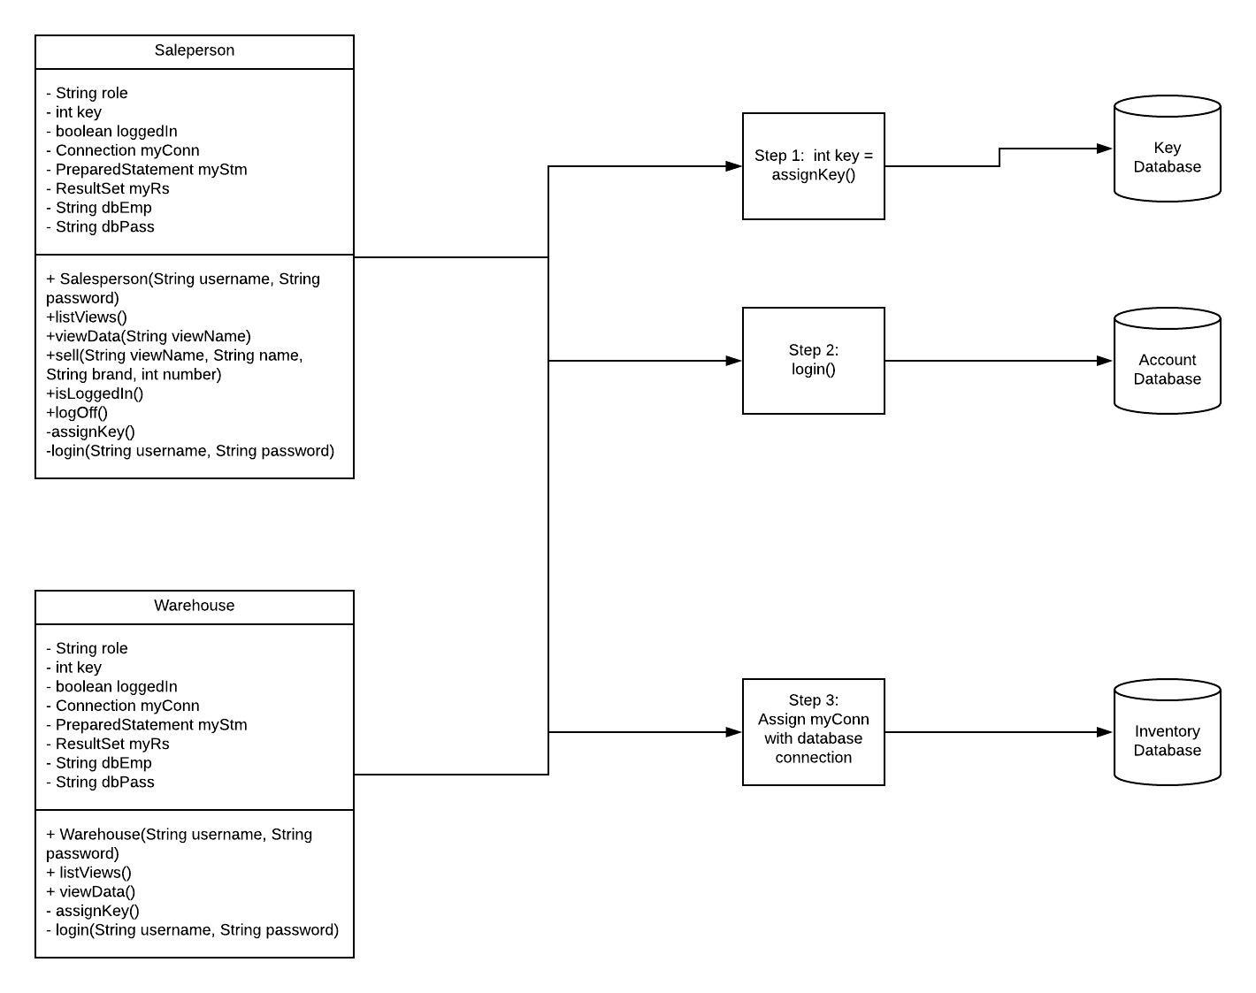
Salesperson and warehouse object
Step 1: Ask the key database
Step 2: Query the server with username & password parameter.
Step 3: Create the connection to the server.

Slide 8
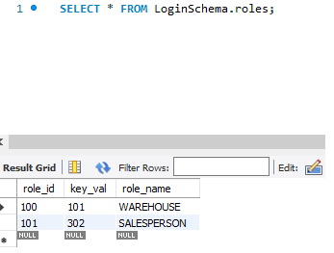
Keys database
A key value is based on role_id.
This key is used for encryption in the Accounts database.
Integrity between the 2 database is enforced by the Custodian object. (You can only create users from the Custodian object)

Slide 9
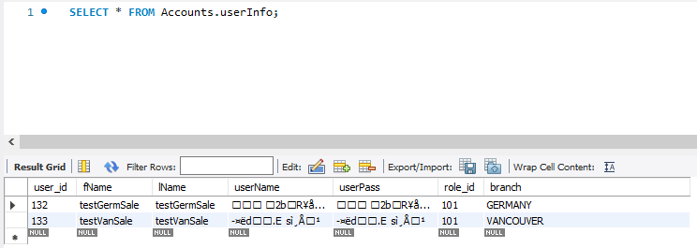
Account database
Trust-no-one approach when it comes to the Account database.
Only stores encrypted user/password combo.
Encrypted combo from client compared to encrypted combo from Database.

Slide 10
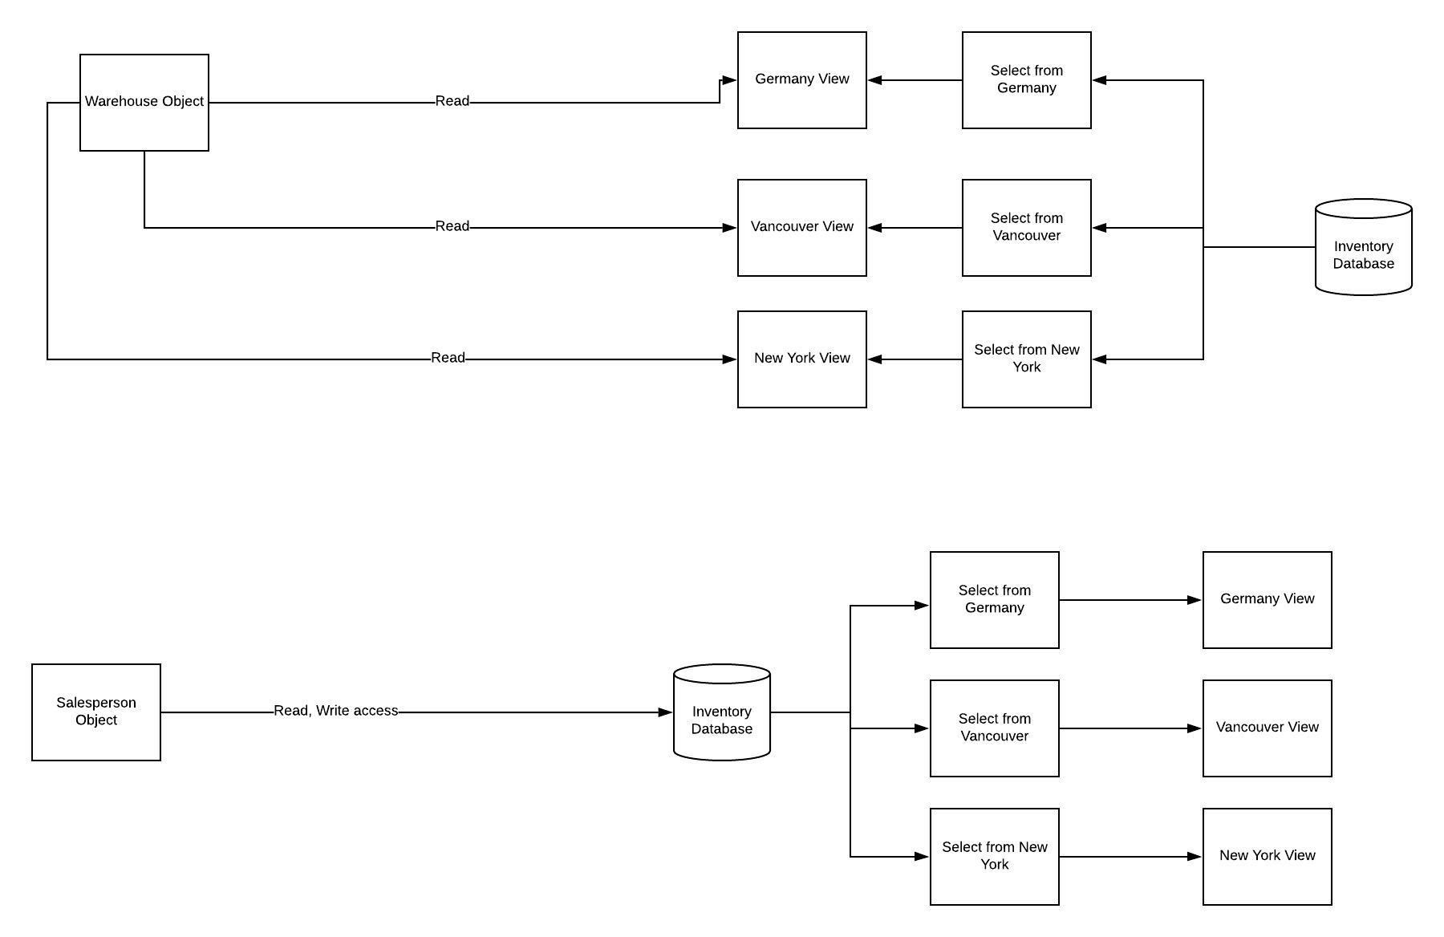
Salesperson/Warehouse interaction
Warehouse queries a VIEW but not any of the actual database tables.
The Views are just SELECT statements ALIAS'd
Salesperson has direct access to Inventory database.

Slide 11
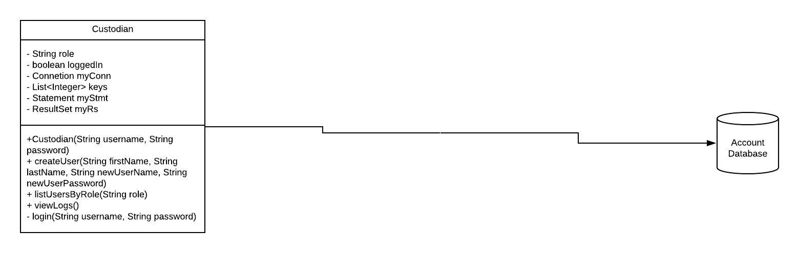
Custodian Object
Connects directly to the database
Account is stored directly into the MySQL server.
Able to create accounts
Able to see all accounts
Able to see logs

Slide 12
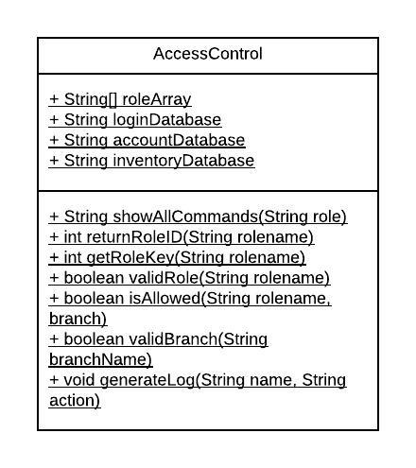
Helper Functions
Quality of life functions
Checking inputs to make sure they are valid.
If they are not valid, return false and do not execute query.

Slide 13
isAllowed
Access is controlled based off user branches time zone.
Time is taken from the database, not locally.
Access (in PST)
Germany branch hours: 11pm to 8am
Vancouver branch hours: 8am to 5pm
New York branch hours: 5am to 2pm

Slide 14
SQL Injection prevention
JDBC provides a means to prevent SQL Injection
Unsafe way (String concatenation)
String sql = "SELECT * FROM userInfo WHERE fName =' "+input+" ";
Input could be "erik'); DROP TABLE userInfo;"
Safe way
String sql = "SELECT * from userInfo where fName = ?"
PreparedStatement statement = connection.prepareStatement(sql);
Statement.setString(1,input)
Output will be "SELECT * from userInfo where fName = ' inputs value'
Also forces field type

Slide 15
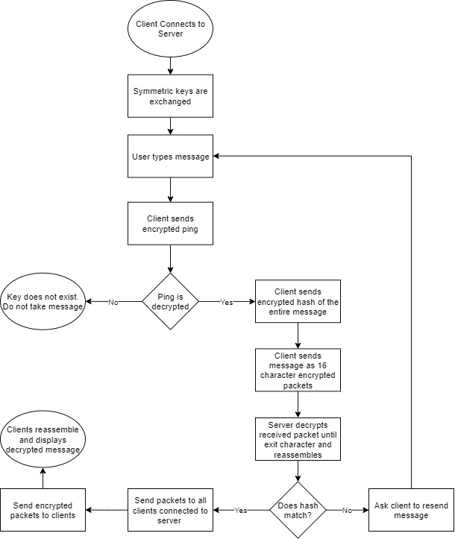
Chatroom Program flow

Slide 16
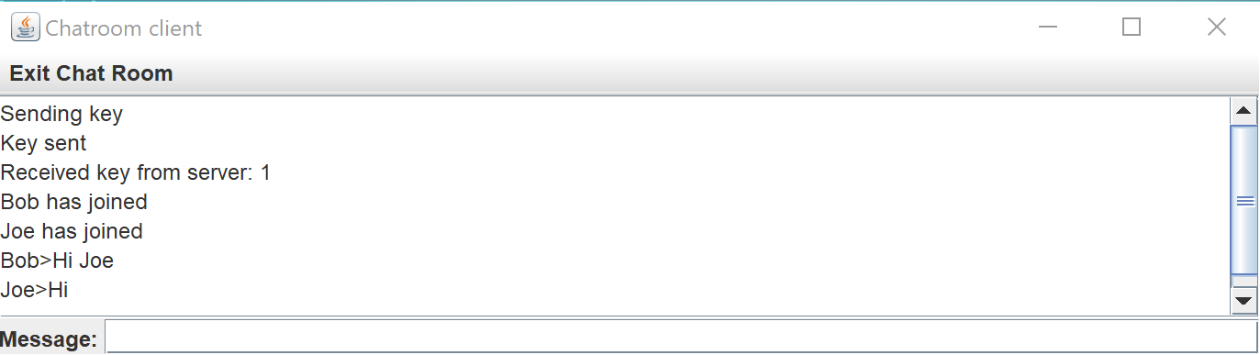
Chatroom client gui

Slide 17
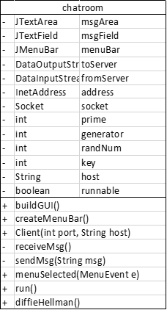
Chatroom CLass
Connects to server
Creates key with diffieHellman()
Pings the server
Sends encrypted message and hash
Decodes received message

Slide 18
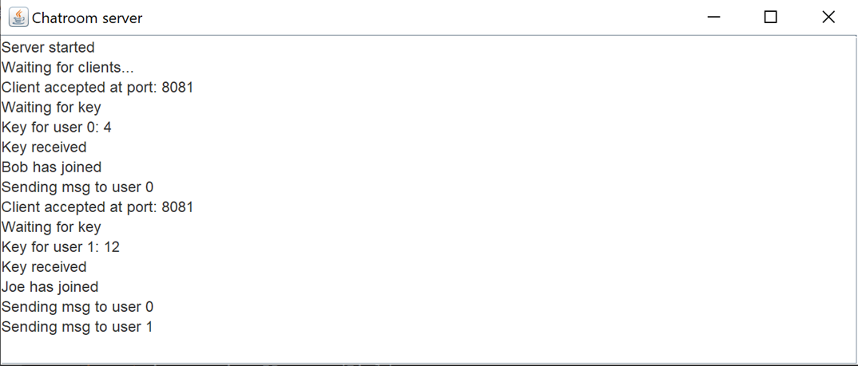
Chatroom server gui

Slide 19
Server Class
Server
- | JTextArea | msgArea
- | DataOutputStream | toClient
- | ArrayList<ClientHandler> | clients
- | int | prime
- | int | generator
- | int | randNum
- | ArrayList<ClientHandler> | keys
+ | diffieHellman()
+ | Server(int port)
Receives messages and verifies integrity
Reroutes re-encrypted messages

Slide 20
Clienthandler Class
ClientHandler
- | DataInputStream | in
- | DataOutputStream | out
- | Socket | socket
- | ClientHandler(Socket socket, DataInputStream in, DataOutputStream out)
- | closeClient(int client)
- | receivedMsg(int id)
- | sendMsg(int client, String msg)
- | findId()
+ | run()
Contains the input and output stream for each client
Creates a thread to receive a message from clients
Used to close a client

Slide 21
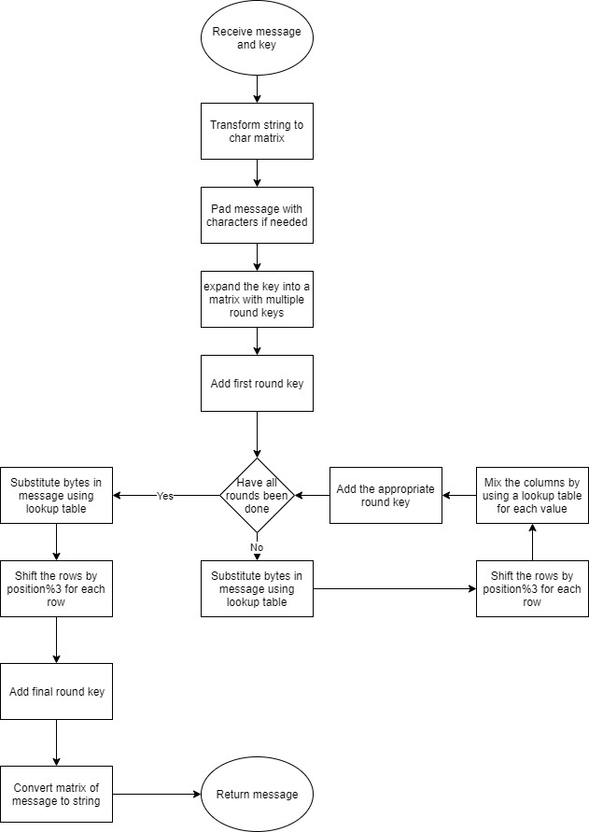
AES encryption Program flow

Slide 22
AES Class
AES
- | int[][] | sbox
- | int[][] | invertSbox
- | int[][] | matrix
- | int[][] | inverseMatrix
- | int[][] | cron
- | int[][] | mc2
- | int[][] | mc3
- | int[][] | mc11
- | int[][] | mc13
- | int[][] | mc14
- | byteSub(int[][] bytes)
- | byteSub(int[] bytes)
- | invertByteSub(int[][] arr)
- | leftShift(int[] bytes)
- | rightShift(int[] bytes)
- | shiftRows(int[][] subbedBytes)
- | invertShiftRows(int[][] subbedBytes)
- | copyMatrix(int[][] bytes, int[][] matrix)
- | mixColumns(int[][] bytes)
- | multCalc(int[][] arr, int I, int j)
- | invertMixColumns(int[][] bytes)
- | invMultCalc(int[][] arr, int i, int j)
- | arrayStart(String msg)
- | padding(int[][] arr, int length)
- | getKey(int key)
- | expandKey(int[][] arr)
- | addRoundKey(int[][] bytes, int[][] key, int round)
- | retString(int[][] arr)
- | encrypt(String msg, int key)
- | decrypt(String msg, int key)
Implements AES-128
Uses lookup tables to prevent timing attack
Encrypts strings of length 16

Slide 23
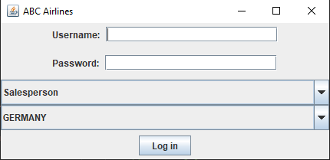
GUI - Login

Slide 24
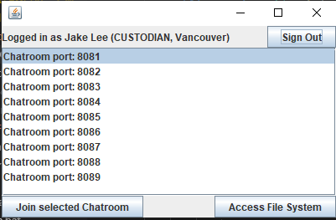
GUI - Session

Slide 25
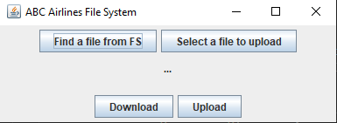
GUI – File system

Slide 26
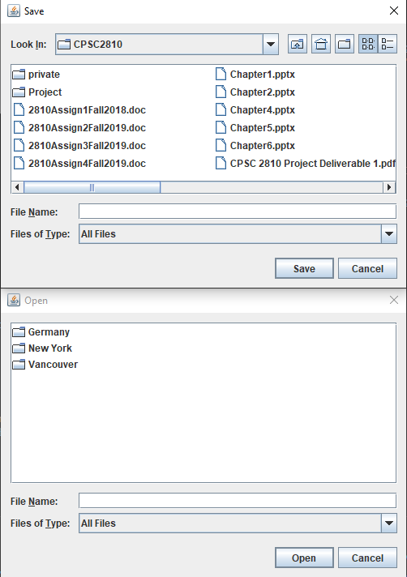
File chooser

